Slide 1

Mid Herts League

Slide 2
Football Mitoo
https://football.mitoo.co.uk/News.cfm?LeagueCode=MHRML2025&NB=0
Please check you are in the correct season.

Slide 3
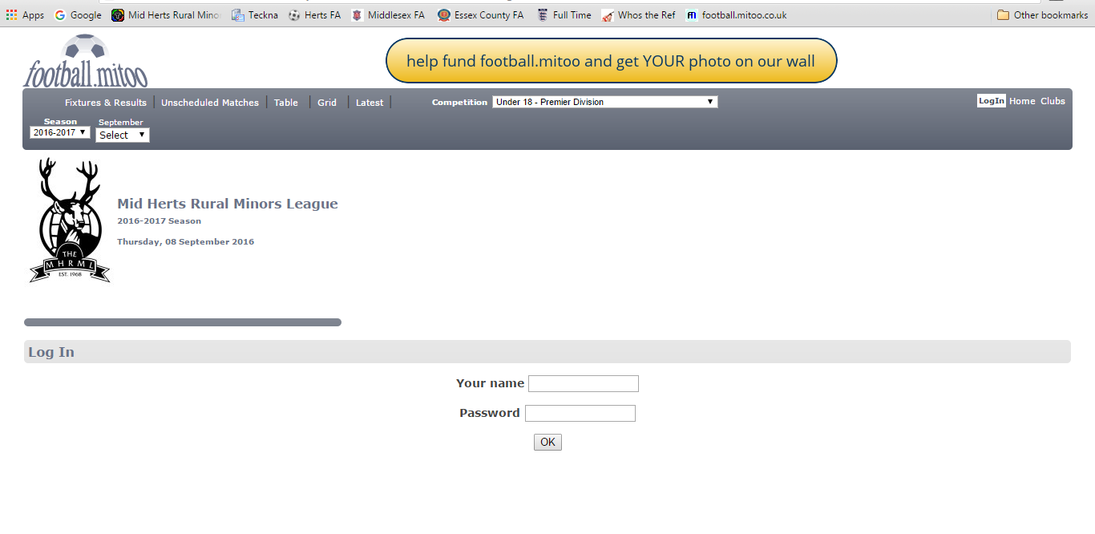
Click Login
Enter your name
and the league password DD3, this gets you access into Mitoo

Slide 4
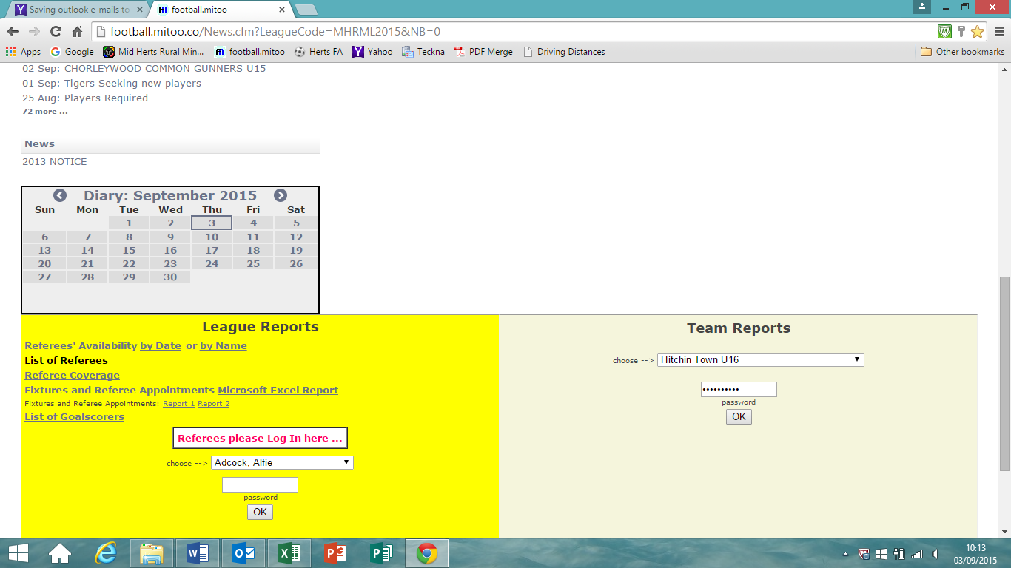
Select your name from the drop down menu
Then enter your unique password and click ok

Slide 5
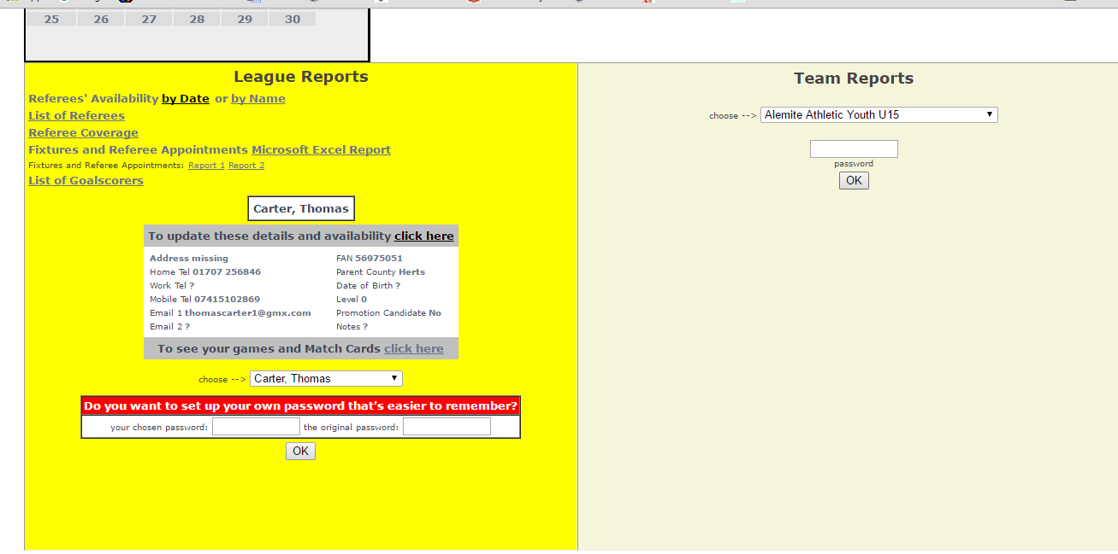
A dialogue box will open, to update your availability click here

Slide 6
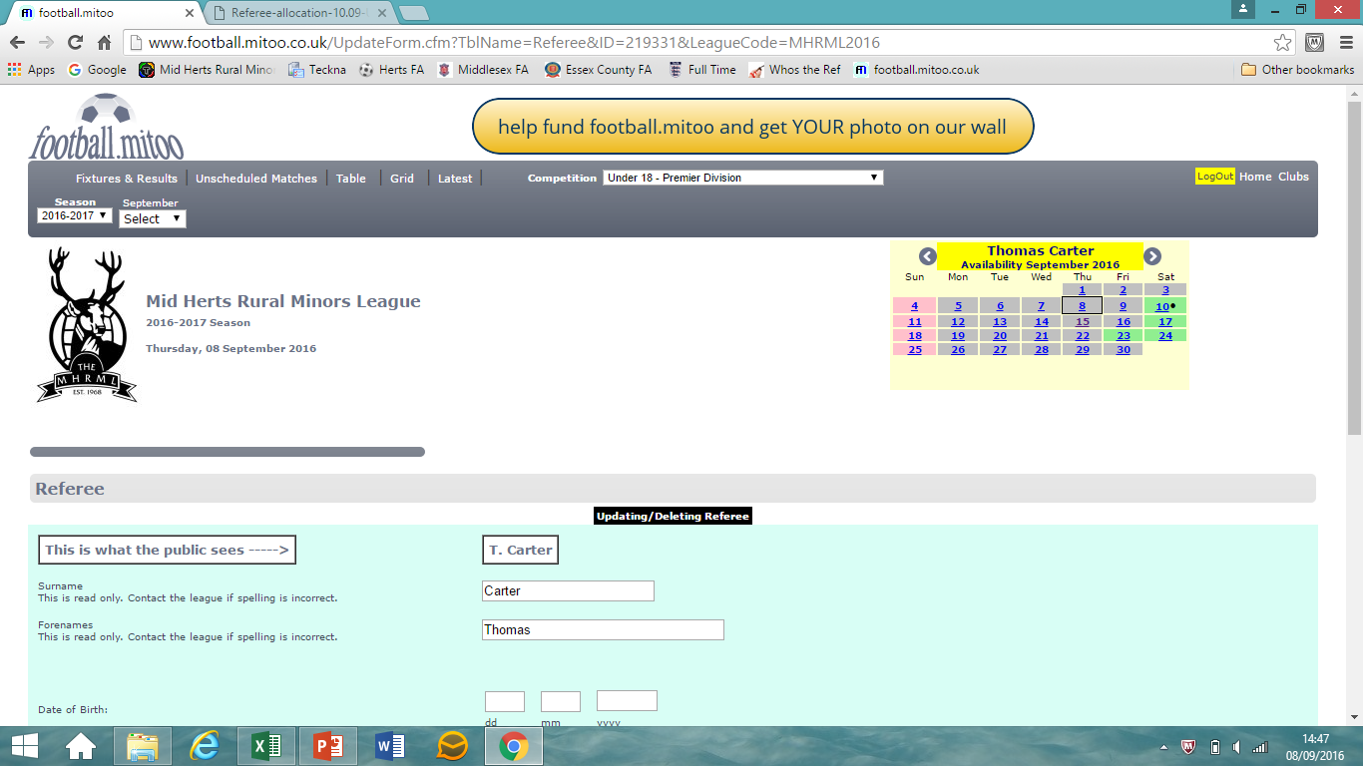
A calendar will open, to update, click on the date and mark yourself as available or not. Please include any additional information such as ‘KO no later/earlier than…’ or ‘one match only’ etc in the comments.

Slide 7
How far in advance do I need to update my availability?
Please update availability as early as possible, but also ensure that it is correct. Work is always going on behind the scenes and allocations may be being worked on before you can see them. Referees who mark themselves as available after midday on the Sunday before may not be allocated matches.

Slide 8
To view your allocated matches click here

Slide 9
How will I be contacted?
How will I be contacted?
You should be contacted by the home team manager no later than 9pm on Tuesday evening.
Please ensure that you respond to this to confirm your attendance.

Slide 10
What if I’m not contacted?
If you are not, send them an email confirming you are the appointed Referee and that you are available and copy either me or Glenn at saturdayrefs@midherts.com or sundayrefs@midherts.com, along with the Club Secretary
Their contact details can be found on the Robin Road App
Teams can and will be fined for not contacting the allocated Referee.
Please do not assume that if you have not been contacted you do not have a match. Please always check on Mitoo yourself.

Slide 11
Can I accept extra games?
Can I accept additional matches
You must not agree to referee any league match without contacting either saturdayrefs@midherts.com or sundayrefs@midherts.com to check that it is ok first.

Slide 12
What do I do if I’m approached to cover another match, when I am already at a ground?
Again, if you have not been appointed to the game by the League, you cannot Referee it without first contacting the correct referee co-ordinator to gain approval.
Why is this?
There are lots of reasons, some of which are:-
(a) There might already be another Referee allocated to the game who could be running late;
(b) They might not have contacted that Referee;
(c) The opposition may have put a complaint in against you or requested not to have you;
(d) You might’ve had trouble with the opposition
(e) You might have an affiliation with the away team;
(f) You might not be suitable for the game;

Slide 13
What if they say, they have cleared it with the League?
Unless you have spoken to a referee co-ordinator, and heard the words, “yes you can do that game”, then it is not ok.
What if they say their game is of higher importance?
The only game that is important is the one you have been appointed to!
If there is any doubt, call Kate or Glenn to clarify before agreeing to anything.

Slide 14
How do I get extra games?
On Monday evening an email will be sent to all Referees with a list of games that have published KO times that are still available. These are on a first come, first served basis but you must reply to the email. All requests should come to saturdayrefs@midherts.com, regardless of which day the fixture is. The deadline to request a match is 9pm on Tuesday, after this our rules state I can no longer appoint referees
Only games on the list, may be picked up.
You must update your availability before replying to the email.
Please DO NOT EMAIL before the list has been emailed out.

Slide 15
What if something changes and I’m unable to referee my allocated game?
You need to notify the correct referee co-ordinator immediately at saturdayrefs@midherts.com or sundayrefs@midherts.com.
You must also contact the home team to inform them immediately. If you are cancelling on the day of the match this MUST be by phone call, not text or email.
The responsibility is YOURS.

Slide 16
MHRML Match Report Cards
Match cards
It is a requirement of being a Mid Herts Referee that the match cards are completed within 48 hours of the match.
It should not be part of the referee
co-ordinators role to have to chase these.

Slide 17
This is done using the following link https://forms.gle/SoJBHqkzuDeqtDMD6

Slide 18
An online system called Ref Sec is replacing our team I.D cards this season, please ensure that managers check these prior to the match. Any player not on their list is NOT allowed to play. There are no exceptions to this.
If the manager is unable to produce this for the whole team the match must be postponed. Take your payment from the team without the team sheet, inform the referee co-ordinator and leave the match.
This is a League Rule

Slide 19
Cautions
All cautions must be reported to the FA on the Referee Portal. This must be done as soon as possible after the match.

Slide 20
How do I find the managers details?
All club contacts, along with committee contacts and our rules can be found on the Robin Road App.
Please download the app then search for Mid Herts League.
If you notice any missing or incorrect details please let us know.

Slide 21
Please make sure you are familiar with the League Rules for the age groups that you have chosen to Referee. One of the biggest complaints we as a League get, is that Referees are not familiar with the Rules for the age group! These can be found in the appendices

Slide 22
County Cup Appointments
Mid Herts do not appoint Referees to County Cups.
We do not get notified of Referees that are appointed to County Cups. So please ensure that you inform us.
County Cups take precedence over League games. If you decline a County Cup appointment, you CANNOT Referee a League game instead.

